Slide 1
Performance Workshop
Dyalog ‘22
Aaron Hsu - aaron@dyalog.com

Slide 2
Syllabus

Slide 3
Theory Physical Implementation

Slide 4
The Comp. Sci. of APL Performance

Slide 5
Big-O

Slide 6
Simplified Reasoning

Slide 7
Big-O
“Families”

Slide 8
Constant: O(k)
Log-Linear: O(n×⍟n)
Linear: O(n)
Polynomial: O(n*k)
Exponential: O(k*n)

Slide 9
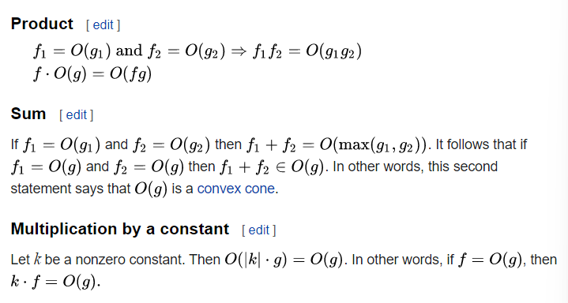

Slide 10
Theoretical Factors of Performance

Slide 11
Run time Memory Usage Memory Access Locality/Caching Parallelism/Critical Path Throughput/Bandwidth Overheads

Slide 12
Physical
Factors of Performance

Slide 13
How many elements?
How many bits?
How many times?
How many?

Slide 14
How much data do you have?

Slide 15
Implementation Factors for Performance

Slide 16
Platform
Runtime
Execution Model

Slide 17
Data First!

Slide 18
The Array Data Structure

Slide 19
<Array Structure Diagram>

Slide 20
Code Data Structure

Slide 21
Token Stream

Slide 22
Variable Lookup

Slide 23
Auxiliary Structures

Slide 24
Caching/
Hashtables

Slide 25
Primitives

Slide 26
Functions

Slide 27
Scalar

Slide 28
Mixed

Slide 29
Operators

Slide 30
Idiomatic APL and “Automatic” Performance Analysis

Slide 31
]RunTime
]SpaceNeeded

Slide 32
Subtleties

Slide 33
f0 ← {+⌿¨⍺⊂⍵}
f1 ← {(1≠⊃⍺)↓¯2-⌿0,(1↓⍺,1)⌿+⍀⍵}
f2 ← {(1≠⊃⍺)↓(+⍀⍺){+⌿⍵}⌸⍵}
f3 ← {1↓x⊣x[+⍀⍺]+←⍵⊣x←0⍴⍨1++⌿⍺}

Slide 34
Memory Management

Slide 35
Let’s look at some tricks

Slide 36
Symbols

Slide 37
Vs. Hashed Primitives

Slide 38
Inverted Tables

Slide 39
When not to use inverted tables?

Slide 40
Flat/Nested Recursive ADTs

Slide 41
PEG vs. LDF

Slide 42
Calculate space of a tree

Slide 43
More Code to Play with

Slide 44
D2P

Slide 45
P2D

Slide 46
Free Vars

Slide 47
Brian’s Code

Slide 48
Basic Rules of Thumb

Slide 49
Flat
Small
Primitive
Parallel

Slide 50
Where can APL outperform traditional languages?
How?

Slide 51
Thank you.

